Slide 1


Cryptocurrency Investigation
Guided By :
Prof. (Dr.) Dipali Kasat

Slide 2




Team Ledger Legends
Fenil Chauhan
GDSC Lead, MLSA. Blockchain Developer
Moksh Agrawal
Blockchain Lead at GDSC.
Riddhika Cheruku
AI SEO Intern at Upmetrics, GDSC- Non Tech Lead
Abhishek Radadiya
Full-stack Developer, Ex-intern at Par Solution as Backend Developer

Slide 3
Agenda
01
Problem Statement
“12 Cryptocurrency Investigation”
02
Key Objectives
03
Our Solution
04
Challenges

Slide 4



Problem Statement

Slide 5



Rise of Cryptocurrency in Illicit Activities : Cryptocurrencies are being used in activities like fake dating profiles, ransomware, investment scams, darknet criminal businesses, and Ponzi schemes. Difficulty in Investigation : Investigating the flow of cryptocurrency becomes difficult due to various methods of hiding and mixing funds.
#12 Cryptocurrency Flow Investigation

Slide 6

Crypto
Currency
Cryptocurrency is a type of digital currency that uses cryptography for security and operates on decentralized networks, typically based on blockchain technology.

Slide 7
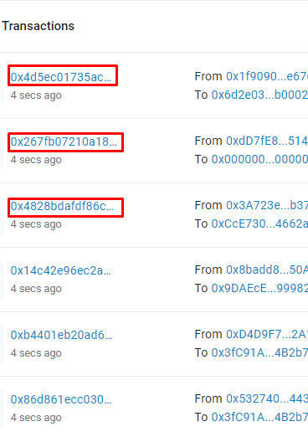
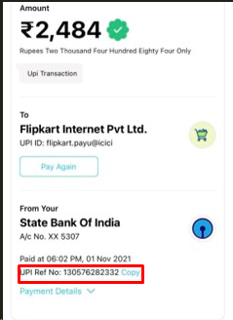

UPI vs Cryptocurrency

Slide 8
Key Objectives

Slide 9

Comprehensive Tracking
Real-Time contact:
Ensure the tool can thoroughly track the flow of cryptocurrency through various stages, from initial illicit activities to crypto-exchanges.
Enable real-time contact with crypto-exchanges and mixer services to expedite the investigation process.
Global Transaction Analysis
User-Friendly Visualization
Provide tools for analyzing and tracking cross-border transactions.
Create an intuitive and user-friendly visualization interface that uses Sankey diagrams for clear representation.

Slide 10
Solution

Slide 11


Solution Flow
A
Visual Flow
B
Hash Input
C
User-Friendly Interface
D
Blockchain Analysis

Slide 12
Technical Considerations

Slide 13




Sankey Diagram Implementation:
Library Choice:
Google Charts
Matplotlib
Mplcursors
sklearn.cluster
sklearn.preprocessing
Security Considerations:
Data Security:
Secure user data, especially in a cryptocurrency.
Website Development :
Technology Stack:
HTML
CSS
JS
Node.js
React.js

Slide 14
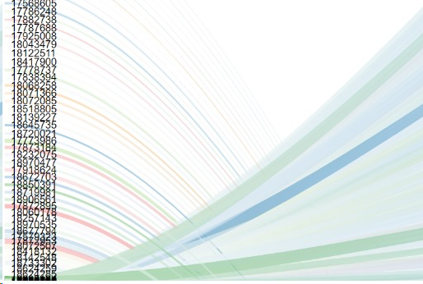
Flow
0x207841b7AE1Ae7757B5E8a1672b3f7fC1df60b9D
Transaction Hash
Construct Request URL
Hash Input
Parse Response
Sankey Diagram
Visual Flow

Slide 15
Sankey Features:
Transaction Flow Visualization:
Display the flow of transactions between wallet addresses, contracts, or nodes in the blockchain
Historical Analysis:
Enable users to analyze historical transaction flows by adjusting the time frame.
Real-time Updates:
Integrate real-time data updates to ensure that the Sankey diagram reflects the latest transactions and movements within the blockchain.
Security and Privacy:
Implements security measures to protect sensitive data while providing authorized users with access to relevant information.
Let’s See some Sankey Diagrams of hash inputs!!!!

Slide 16
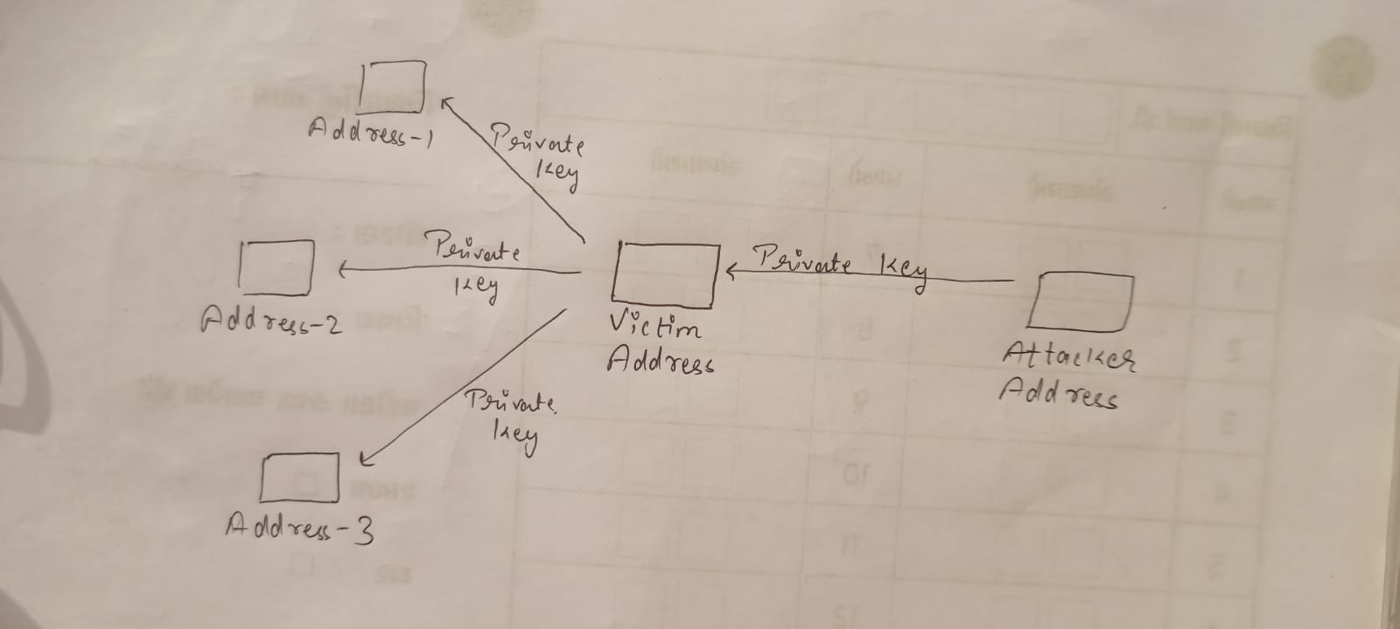
Private Key Compromise

Slide 17
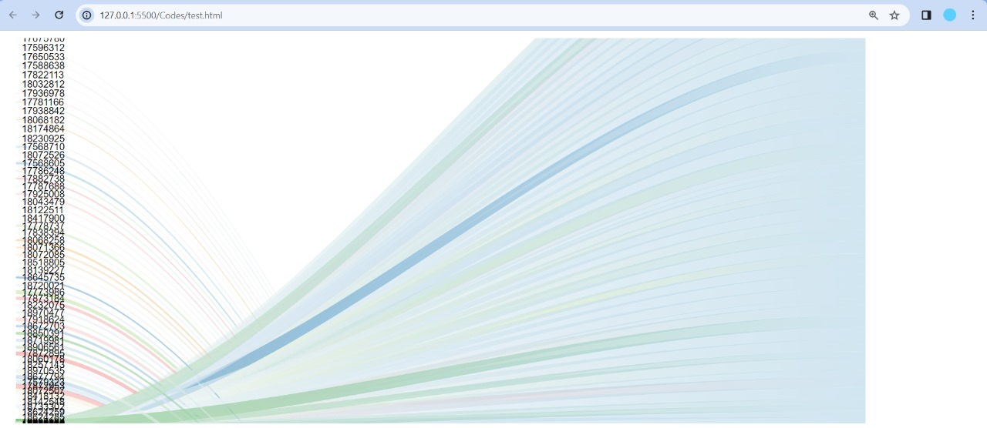

Slide 18
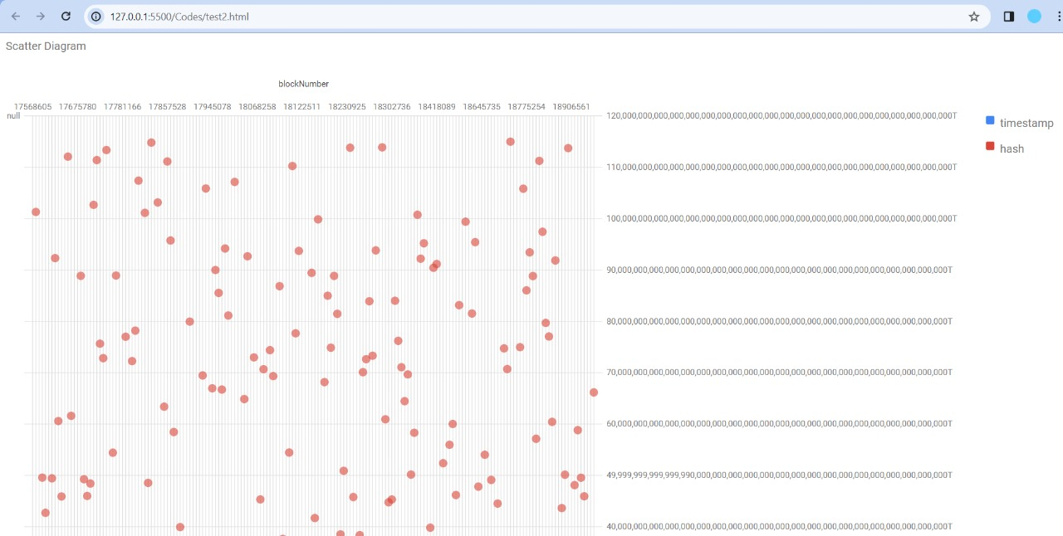

Slide 19
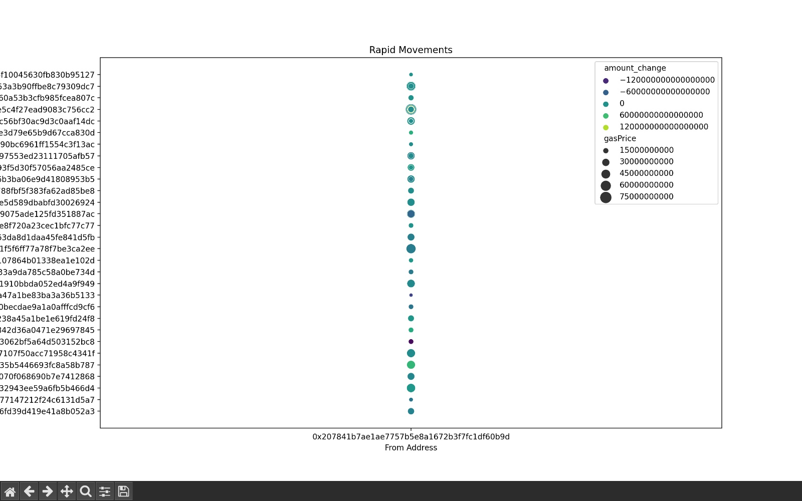
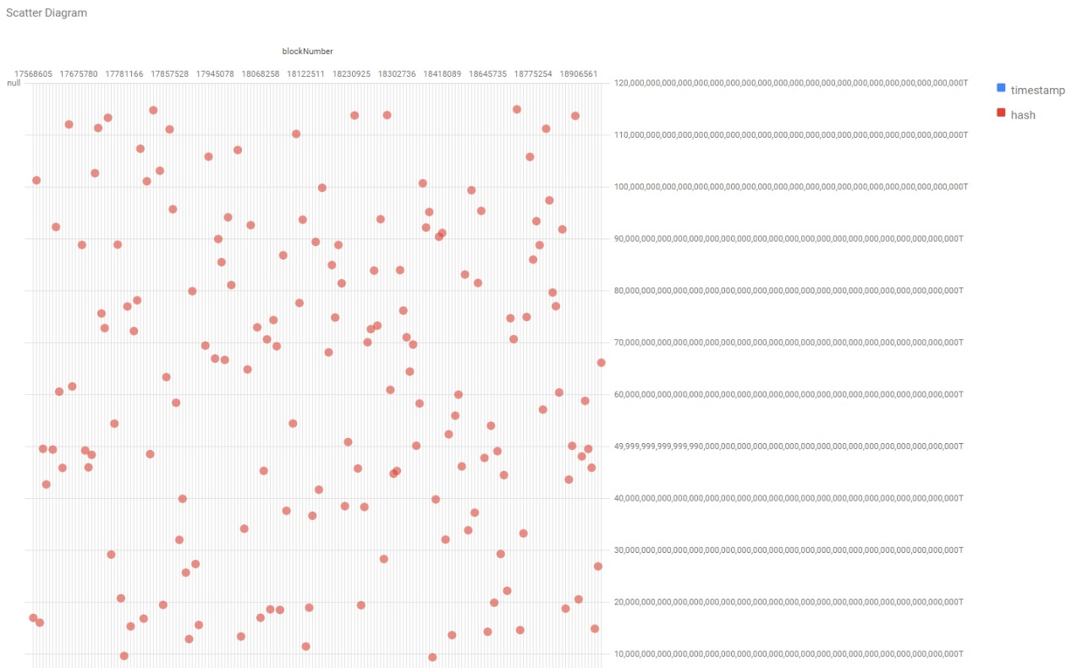
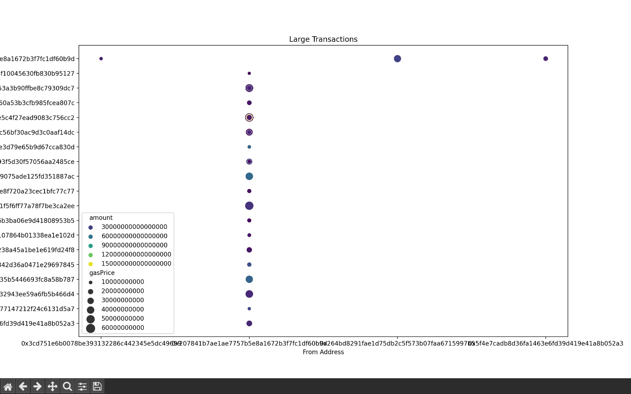
Heuristic Analysis

Slide 20
Sanky Diagram

Slide 21
Large Transaction Analysis

Slide 22
Scatter Diagram

Slide 23

Challenges

Slide 24
Privacy Tools:
Rules and Different Countries:
People use special tools to keep their cryptocurrency transactions private. This makes it hard for investigators to see where the transaction is coming from and going to.
Web Integration
Cryptocurrency transactions happen across different countries, each with its own rules. There isn't a consistent way to deal with this globally.
Sankey diagram implementation.
Cryptocurrency transactions are continuous, and real-time updates are crucial for investigation.

Slide 25
Future Scope

Slide 26
Quantum-Resistant Cryptographic Techniques
Data visualization methods by incorporating augmented reality (AR) or virtual reality (VR) for better explore and understand cryptocurrency flows.
Transaction Pattern Analysis:
The understanding of transaction patterns associated with various activities, such as dark web transactions, ransomware payments, and other illicit uses of cryptocurrencies.

Slide 27
THANK YOU
Team Ledger Legends

